Slide 1
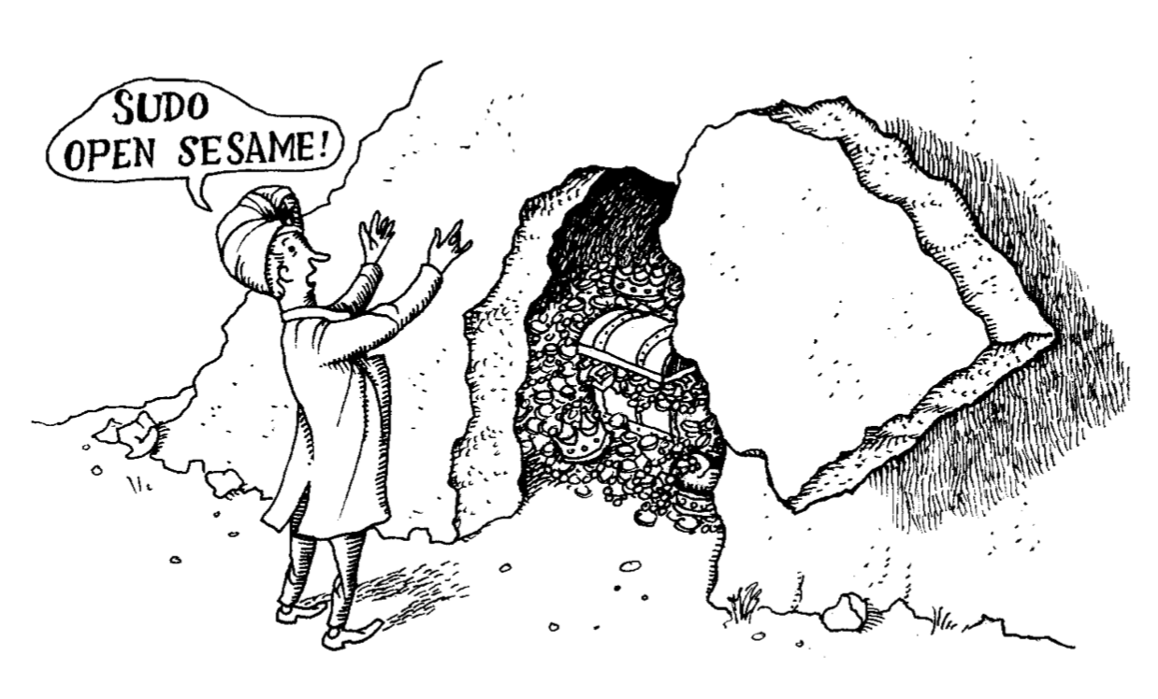
Access Control & Root

Slide 2
Standard UNIX Access Control
Access control decisions depend on which user is attempting to perform an operation (or possibly what group they belong to)
Objects (files, processes, etc.) have owners and owners generally control their own objects
You own the objects you create
The special “root” user can act as the owner of any object (!)
Only root can perform certain administrative operations

Slide 3
Filesystem Access Control
Files are only owned by a single person, but other users may have permissions to work with a file
Permissions are set on a file on a user, group, and all users granularity
drwxr-xr-x 4 briancrites staff 128 Mar 27 11:47 IO
(1) special permissions character, (3) user characters, (3) group characters, (3) all users characters
d: special bit (this one means its a directory)
r: read, w: write, x: execute
Notes:
Users are actually identified by UIDs not names, bindings of which are located in /etc/passwd
Groups are actually identified by GIDs not names, bindings of which are located in /etc/group

Slide 4
Change Mode (chmod)
Command used to modify the permissions of a file
Allows you to set user, group, other, and all permissions to read, write, execute, or do nothing
chmod u=rwx,g=rx,o=r myfile
chmod +x myfile
chmod a-x myfile

Slide 5
Process Ownership
Process owners can send them signals and modify their priority (niceness)
Every process has the following identities associated with them
Real UID/GID: used for UID/GID accounting when switching permissions
Effective UID/GID: used to determine access permissions (usually the same as real)
Saved UID/GID: parking spot allowing the process to switch in and out of privileged mode

Slide 6
Root Account
Can run any valid command on any file in the system (UID 0)
Can also run privileged commands, such as:
Creating device files
Setting the system clock
Raising resource usage limits and process priorities
Setting the system’s hostname
Configuring network interfaces
Opening privileged network ports (< 1024)
Shutting down the system
Root keeps no logs of its actions and has infinite power, so you should probably disable login to it whenever possible
Notes:
The root account also has a UID of 0
When it is not possible to disable the root account create a strong password and limit who has access to it

Slide 7
setuid and setgid
Special permissions (denoted by an s rather than x in permissions list)
Allows for execution as another UID or GID (usually root, UID 0) rather than the user who is trying to invoke it
Allows users to execute some functionalities that would normally require root permissions (changing passwords for example)
This creates security problems, and only program that were specifically designed with setuid in mind (and a minimum number of those) should be allowed
This functionality can be turned off by adding nosuid parameter when mounting a file system (mount command)
Notes:
Disallowing setuid when mounting a filesystem that you don’t trust or has untrusted user code is important as it reduces the changes of a security vulnerability from this feature

Slide 8
su: substitute user identity
Allows you to switch user identifies (and therefore access and powers)
Usually used to switch to root (although you can switch to anyone else)
Users must supply passwords to accounts they switch to (including root)
Root can switch to anyone else's account using su without a password (!)
Records the account switch, but not commands run by root
su - username allows you to switch to a user and use their bash profile, can be very useful for diagnosing user problems you don’t see as an admin

Slide 9
sudo: limited su (preferred method)
Users need access to administrative permission levels to do normal tasks (change passwords, create backups, etc.)
Giving them broad permissions creates security hazards
Limit the number of commands that they have access to run, and try and choose as small a selection as possible for them to do their jobs
Sudo allows you to dictate what commands that require permissions a user can run, rather than giving them broad permissions and asking them to relinquish them
Standard in all distributions, but technically a stand alone product which can be downloaded from source here https://www.sudo.ws/sudo/sudo.html

Slide 10
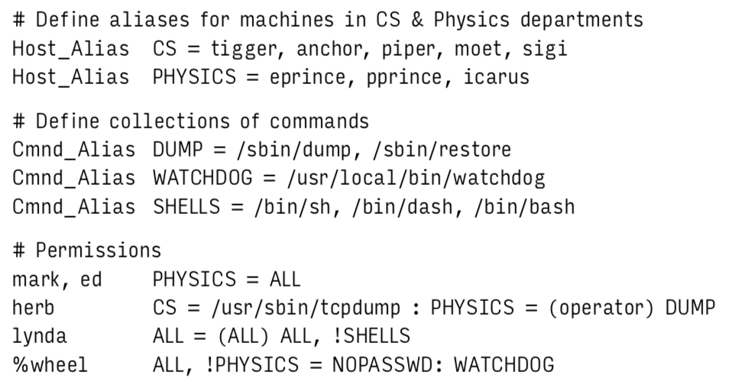
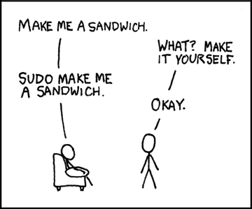
sudoers File
Describes who has access to what commands
Allows for grouping of users (Host_Alias) and grouping of commands (Cmnd_Alias) to make assigning permissions easier
sudo commands are logged
Use visudo to edit (checks for multiple editors, opens editor, and checks sudoers file is valid)
Notes:
sudo logs command lines executed, hosts which ran them, people who ran them, directories where they were run, and the time they were invoked
Is typically sent to syslog but can also go to a file of your choice (syslog recommended to allow forwarding to central log repository)
There is also a “User_Alias” similar to Host_Alias and Cmnd_Alias which allows users to be grouped for permissions

Slide 11
sudoers File
Host_Alias creates groups of hosts which will allow us to break up who (users) can do what (commands) where (hosts)
Cmnd_Alias creates groups of commands, usually related by functional need rather than user need
Each permission line is made up of the following pieces
The user(s) to whom the line applies
The hosts on which the line applies
The commands the specified user can run
The users the commands should be executed as

Slide 12
sudoers File
The user “herb” can run tcpdump on CS machines and dump-related commands on PHYSICS machines, but the dump commands can only be run as the “operator” user, not as root
The user “lydia” can run all commands on all machines as any user, but isn’t allowed to run some common shells
Note lydia can still gain shell access by copying a shell to another location and executing it, so trying to exclude behavior isn’t really possible using sudo
Notes:
Note: colons both follow tags (such as NOPASSWD:) and are used to separate compound rules (such as CS = /usr/sbin/tcpdump : PHYSICS = (operator) DUMP)

Slide 13
Additional sudoers File Tips & Tricks
The default sudoers file is perfectly acceptable for most cases
User_Alias ADMINS = alice, bob, charles
ADMINS ALL = (ALL) ALL
Sudo commands use a reduced and sanitized environment, you can add things to the default with Defaults env_keep += “ADDITIONAL_PATH”
If there are multiple lines that could match, sudo will choose the last matching line in the file to have precedence
You can use a single sudoers file to administer multiple hosts, either through configuration management tools or through a cron job which pulls the file from a (heavily watched) server

Slide 14
sudo pros and cons
Accountability is much improved because of command logging
Users can do specific chores without having unlimited root privileges
The real root password can be known to only one or two people
Using sudo is faster than using su or logging in as root
Privileges can be revoked without the need to change the root password
A canonical list of all users with root privileges is maintained
The chance of a root shell being left unattended is lessened
A single file can control access for an entire network
A breach in a single account can be similar to a breach in root
Sudo command logging can be subverted (but the subversion is usually logged)
Notes:
You can run sudo sh or sudo su to run a terminal as root, which is not logged. The command to get you there is logged though

Slide 15
Disabling root
Root (or any other account) can be made inaccessible by changing its password to *
This disallows logging into the account, but still allows sudo and root related systems to function (root still exists)
Generally you want a root account on physical machines, as hardware or configuration problems may require root to rescue the machine
It is also customary to disable system (UID < 10) and pseudo-system (10 - 100) accounts by replacing their passwords with *
Use /etc/shadow or /etc/master.passwd file, and set their shells to /bin/false or /bin/nologin
Notes:
Changing the password to * makes it impossible to access because the * cannot be hashed
The /bin/false is an executable that just immediately exists, /bin/nologin prints a message which can be configured about a module missing

Slide 16
sudo vs. advanced access control
You decide exactly how privileges will be subdivided
Simple configurations are easy to set up, maintain, and understand
sudo runs on all UNIX/Linux systems
You can use a single config across all machines
You get default syslogging for free
All user accounts are potentially exploitable to gain root access
Not a safe way to define limited domains of autonomy
Not a safe way to place certain operations out of bounds

Slide 17
Advanced Access Controls
Pluggable Authentication Modules (PAM)
Module for allowing multiple types of authentication (not technically access control)
Kerberos (Network Cryptographic Authentication)
Authentication service used in conjunction with PAM, a single server can provide authentication for an entire network of machines
Access Control Lists (ACL)
Allows you to set permissions for multiple users and groups at once
Notes:
We will talk about a number of these later in the course

Slide 18
Modern Access Control
Mandatory Access Control (MAC)
Allows administrators to dictate access control which overrides user set permissions
Role-based Access Control (RBAC)
Users belong to role(s) which form permission hierarchies
SELinux: Security-Enhanced Linux
Security implementation combining flavors of MAC and RBAC
Becoming more popular in security intensive fields (government, healthcare, finance)
Fairly difficult to administer correctly
Notes:
Each of these is implemented using a number of different systems depending on your environment

Slide 19
Questions?

Slide 20
Additional Resources
Sudoers File Official Documentation

